Slide 1
Repeat Buyer Prediction
IS675 - Deep Learning for Business
Group 11
Akanksha, Prayag, Sanket

Slide 2
TABLE OF CONTENT
Introduction
Problem statement
Data
Data preprocessing
EDA
Feature engineering
Feature ranking
Modeling

Slide 3
Problem Statement
Our dataset includes information on promotional shopping events from an e-commerce platform.
The task is to design a system that will increase the ROI
We need to predict the probability that the new buyers would purchase items from the same merchants again within six months,
reduce promotional costs, and
identify one-time buyers.

Slide 4
Need for Repeat Buyer Prediction Model
Businesses constantly struggle to understand customer needs, loyalty, and behavior and have lot of customer’s activity data.
They often try to leverage this data for promotional sales or Loyalty program.
Unfortunately, many customer end up being as single-time buyers.
So, the business needs to identify loyal customers who have repeatedly bought items and tailor the deals based on their information to gain profits.

Slide 5
Data Fields | Definition
user_id | A unique id for the shopper.
age_range | User' s age range: 1 for <18; 2 for [18,24]; 3 for [25,29]; 4 for [30,34]; 5 for [35,39]; 6 for [40,49]; 7 and 8 for >= 50; 0 and NULL for unknown.
gender | User's gender: 0 for female, 1 for males, 2 and NULL for unknown.
merchant_id | A unique id for the merchant.
(Target Variable) Label | It is an enumerated type {0, 1}, where 1 means repeat buyer, 0 is for non-repeat buyer. This field is empty for test data.
activity_log | Set of interaction records between {user_id, merchant_id}, where each record is an action represented as ' item_id:category_id:brand_id:time_stamp:action_type' . ' #' is used to separate two neighboring elements. Records are not sorted in any particular order.
Data
The Given Data consists of user activity over the e-commerce platform for the last six months.
We used a subset of this data which consisted of 150 item-ids.
The Label is our Target Variable.

Slide 6
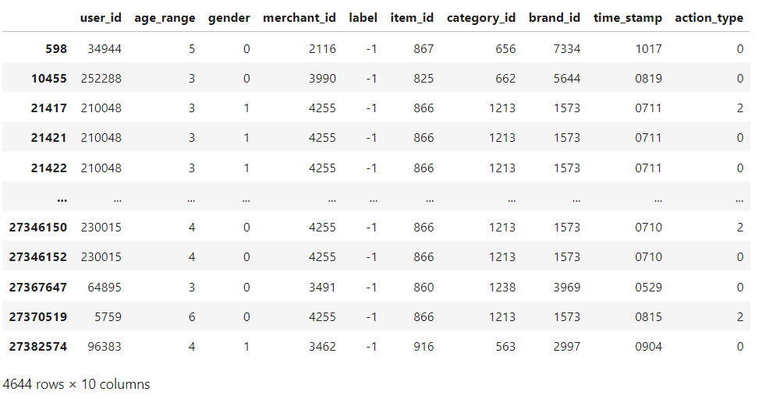
Data Pre-Processing
and the steps we followed
Replaced null and unknown values with their respective numeric encoding.
Split the activity_log column at every occurrence of the "#" symbol.
Separated the features encoded in the activity_log by the ":" symbol.
Filtered the data based on the item_id values (item_id: 801-960).

Slide 7
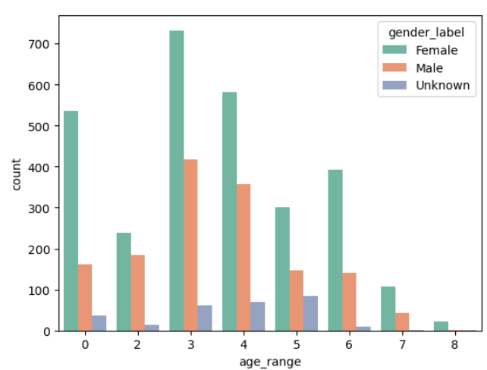
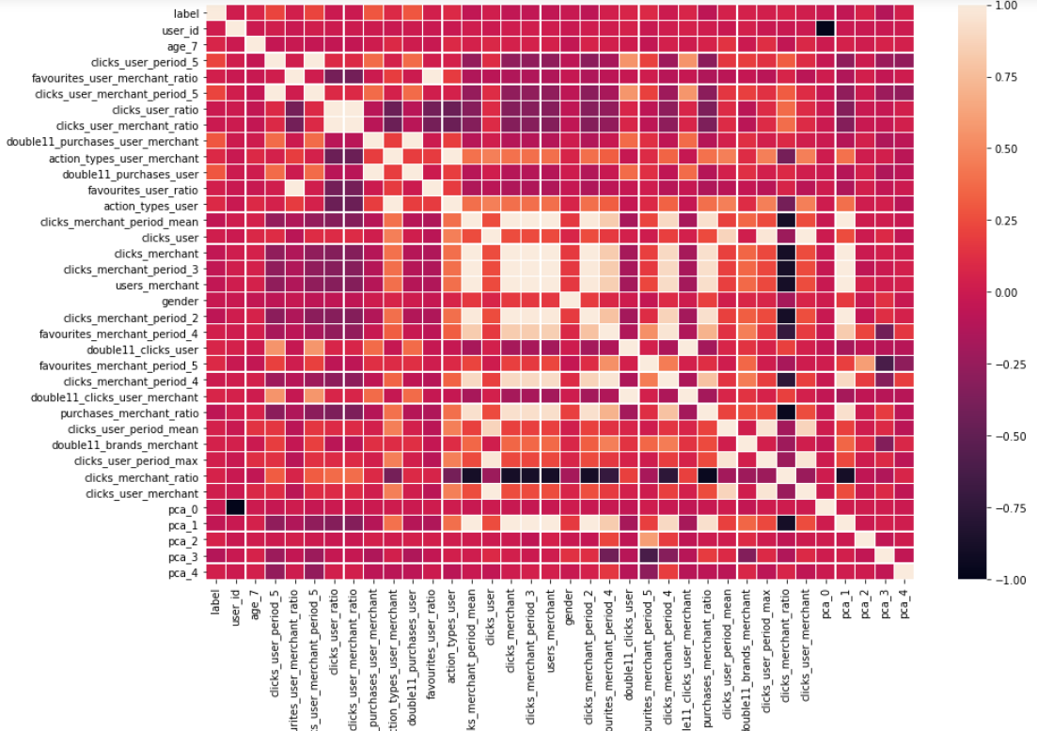
Exploratory Data Analysis (EDA)
Fig: 1
Explored gender distribution of data by age groups and found most females belonged to age group three. Added to that, we found age groups three, four, and five have almost equal numbers of unknown observations.
Created a correlation plot to perform data statistics.
Fig: 2

Slide 8
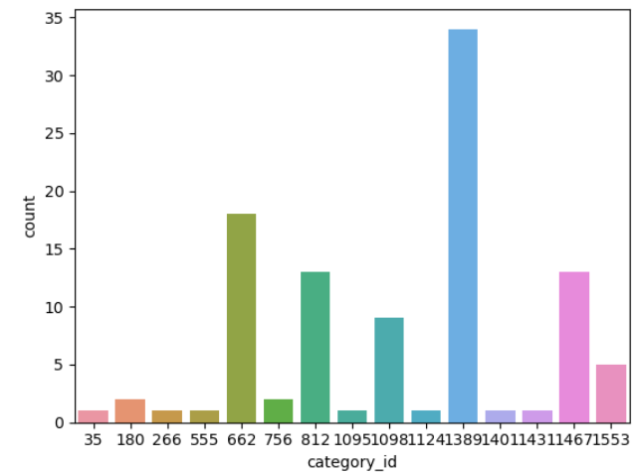
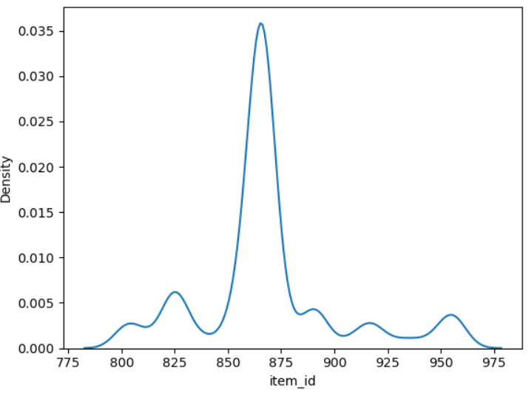
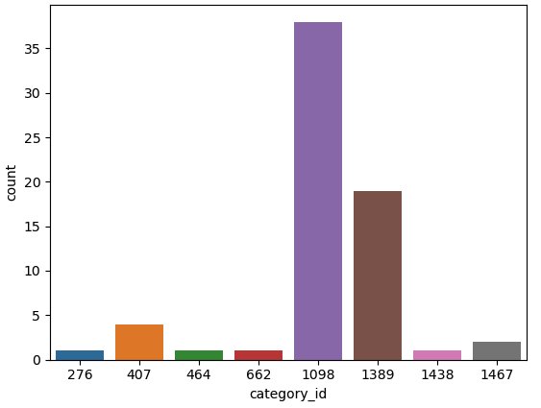
Exploratory Data Analysis (EDA)
Fig: 3
Fig: 4
FEMALES
MALES
Observed that most sales happened on promotion days and visualized how brands, users, and items worked together.
Plotted the popularity of items among users.
Categorized overall activity by gender using pie charts

Slide 9
Feature Engineering
We used the Processed dataset to engineer a total of 153 features based on the basic user-merchant logic.
The features can be classified into various categories such as
time-related features,
count features,
action count features,
ratio of actions features,
monthly features and double 11 Features.

Slide 10

Feature Ranking
In our project we used three methods for feature ranking, and we chose the best performing one.
- A Regression Model
- SHAP
- Random Forest Regressor
These models were used to generate feature lists.
The features from the random forest regressor produced the best results when tested with various models, so they were chosen for the final prediction task.

Slide 11
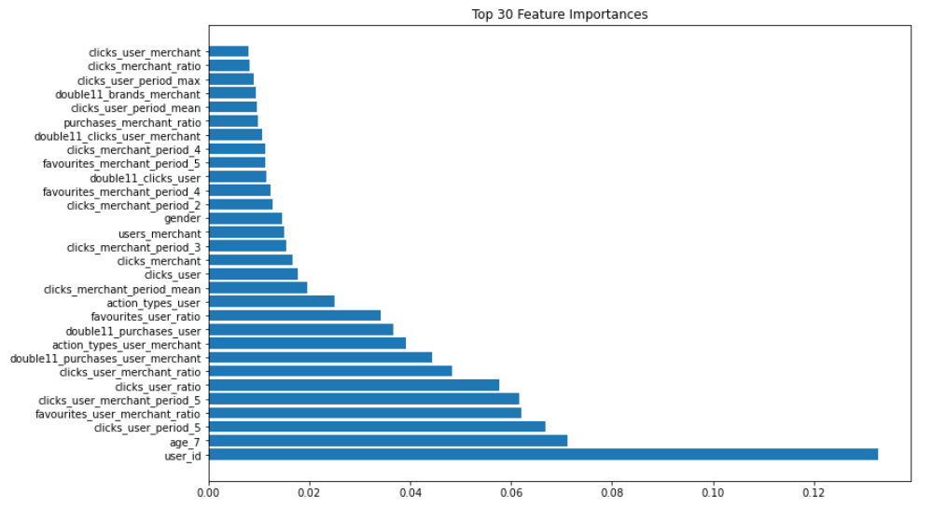
Results Of Feature Ranking
Features using Random forest regressor

Slide 12
Strategies and Methodologies used
Feature Engineering
Feature Importance
One-hot encoding
PCA
Down-sampling (Majority-Minority class) for dealing with Imbalanced data.
Model training and testing

Slide 13
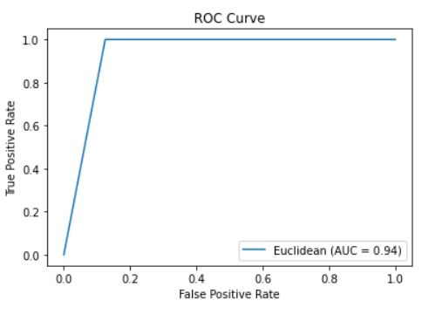
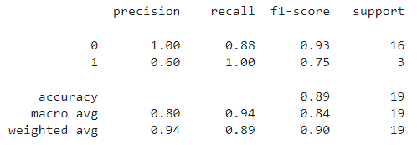
1. Baseline Model (Random Forest)
We decided to start with the random forest model as our baseline model and compare this model with the classic machine learning models.
The random forest model was able to achieve an accuracy of 89 percent on the reduced features and PCA data.

Slide 14
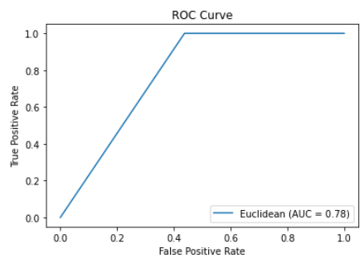
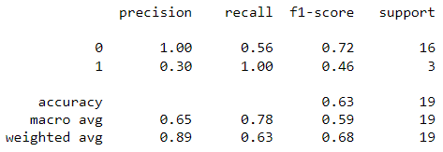
2. Bayes Classifier
After Random Forest we used Bayes Classifier.
A grid search was conducted to test which hyperparameter yielded the best results.
Also, five-fold cross-validation was done.
After these steps, the modeling and prediction were performed, in which the model gave an accuracy of 0.63.
As you can see, it underperformed compared to our baseline model.

Slide 15
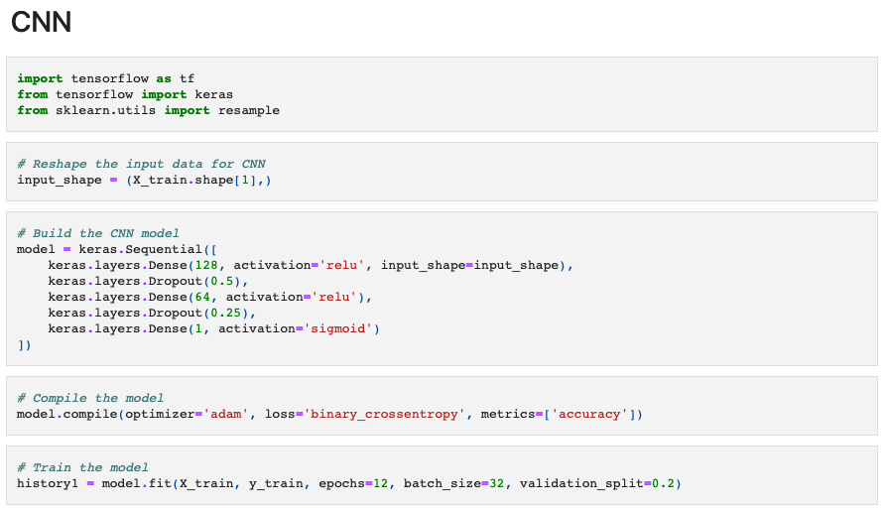
3. Convolutional Neural Networks

Slide 16
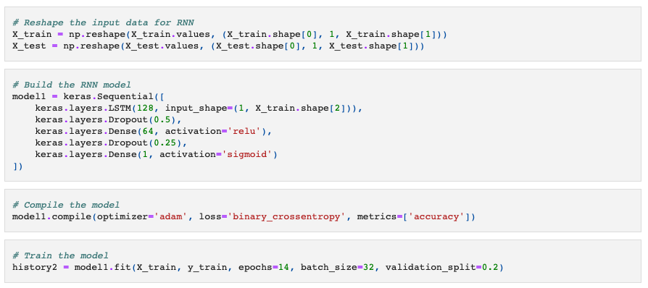
3. Recurrent Neural Networks

Slide 17
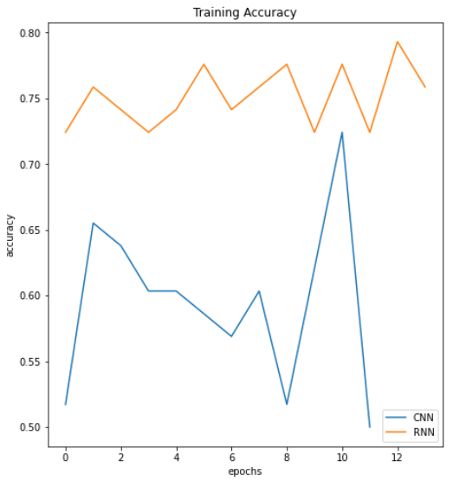
CNN and RNN Accuracies
Neural networks (CNN and RNN) were used to check if it could perform better and improve label value prediction.
CNN and RNN achieved an accuracy of 0.73 and 0.84 respectively, as shown in the graph.

Slide 18
Conclusion
Among our tests, Random Forest had BEST accuracy rate with 0.89 followed by RNN with 0.84.
Random Forest
Bayes Classifier
CNN
RNN
89%
Accuracy
63%
Accuracy
73%
Accuracy
84%
Accuracy
Insights
Loyalty may not necessarily translate to higher interest in special events or promotions- based on analysis of customer behavior on Double 11 Day and the period in which Double 11 Day occurs.
Click-merchant ratio and frequent browsing with a single merchant were strong indicators of customer loyalty.
Merchants who offer a limited number of brands tended to have more loyal customers, indicating a preference for a focused selection of products from a trusted source.

Slide 19
Thank you !
Any Questions?

